Slide 1
Module 8
Visualizing Geographic Data with ggmap

Slide 2
Contents
• Creating a basemap
• Adding operational layers
• Adding layers from a shapefile/vector file

Slide 3
Visualizing Geographic Data with ggmap
The ggmap package enables the visualization of spatial/location/geographic data and spatial statistics in a map format using the layered approach of ggplot2.
This package also includes basemaps that give your visualizations context including Google Maps, Open Street Map, Stamen Maps, and CloudMade maps.
In addition, utility functions are provided for accessing various Google services including Geocoding, Distance Matrix, and Directions.
ggmap: A collection of functions to visualize spatial data and models on top of static maps from various online sources (e.g Google Maps and Stamen Maps) with layered implementation of ggplot2.)

Slide 4
Visualizing Geographic Data with ggmap (cont…)
As the ggmap package is based on ggplot2, it will consist of the same five components found in ggplot2.
These include a default dataset with aesthetic mappings where x is longitude, y is latitude, and the coordinate system is fixed to Mercator projection. (because of the Mercator projection limitations in mapproject, anything above/below ±80 degrees cannot be plotted currently. Ref-http://stat405.had.co.nz/ggmap.pdf)
Other components include one or more layers defined with a geometric object and statistical transformation, a scale for each aesthetic mapping, coordinate system, and facet specification.

Slide 5
Creating a basemap:
There are two basic steps to create a map with ggmap.
Download the images and format them for plotting, with get_map which can be used to create basemap from Google, Stamen, Open Street Map or CloudMade.
2. Make the plot, with ggmap.
Download the map raster (basemap) and then plot operational data on the basemap.

Slide 6
Exercise 1: Creating a basemap
Make sure the working directory is set and ggmap package is loaded.
2. Create a variable called myLocation and set it to California.
myLocation <- "California"
3. Call the get_map() function and pass in the location variable along
with a zoom level of 6.
myMap <- get_map(location = myLocation, zoom = 6)

Slide 7
Exercise 1: Creating a basemap (cont…)
4. In RStudio you should see some return messages that look similar to the code you see below. If you don’t see something similar to this, you may need to reexecute the script. It isn’t uncommon to get an error message when calling the get_map() function from R Studio. If this happens simply re-execute the code until you get something that is similar to what you see below.
Map from URL: http://maps.googleapis.com/maps/api/staticmap?center=California&zoom=6&size=640x640&scale=2&maptype=terrain&language=en-EN&sensor=false
Information from URL : http://maps.googleapis.com/maps/api/ geocode/json?address=California&sensor=false

Slide 8
Exercise 1: Creating a basemap (cont…)
5. Call the ggmap() function, passing in the myMap variable.
The default map type is Google Maps with a style of Terrain
ggmap(myMap)
6. Add and execute the code you see below to add a Google satellite map.
myMap <- get_map(location = myLocation, zoom = 6, source="google", maptype="satellite")
ggmap(myMap)

Slide 9
Exercise 1: Creating a basemap (cont…)
7. There are a number of ways that you can define the input location:
longitude/latitude coordinate pair, a character string, or a bounding
box.
The character string tends to be a more practical solution in many situations since you can simply pass in the name of the location. For example, you could define the location as Houston Texas or The White House or The Grand Canyon.
When a character string is passed to the location parameter it is then passed to the geocoding service to obtain the latitude/longitude coordinate pair.
myMap <- get_map(location = "Grand Canyon, Arizona", zoom = 11)
ggmap(myMap)

Slide 10
Exercise 1: Creating a basemap – stamen background
# Library
library(ggmap)
library(gridExtra)
# For stamen map, you have to give the extremity of the window you are looking at. here is an example with the watercolor background (Around brisbane)
map <- get_stamenmap( bbox = c(left = 110, bottom = -40, right =160, top = -10), zoom = 4, maptype = "watercolor")
ggmap(map) + theme_void() + theme( plot.title = element_text(colour = "orange"), panel.border = element_rect(colour = "grey", fill=NA, size=2) )

Slide 11
Adding Operational data layers:
ggmap() returns a ggplot object, meaning that it acts as a base layer in the ggplot2 framework.
This allows for the full range of ggplot2 capabilities meaning that you can plot points on the map, add contours and 2D heat maps, and more.
Exercise 2:
Add the code you see below to produce a map of California that displays wildfires from the years 1980-2016 that burned more than 1,000 acres.
myLocation <- "California"

Slide 12
Exercise 2(cont…)
#get the basemap layer
myMap <- get_map(location = myLocation, zoom = 6)
#read in the wildfire data to a data frame (tibble) dfWildfires <-
read_csv(“StudyArea_SmallFile.csv”, col_names = TRUE)
#select specific columns of information
df <- select(dfWildfires, STATE, YEAR_, TOTALACRES, DLATITUDE, DLONGITUDE)
#filter the data frame so that only fires greater than 1,000 acres burned in California are present
df <- filter(df, TOTALACRES >= 1000 & STATE == ‘California’)

Slide 13
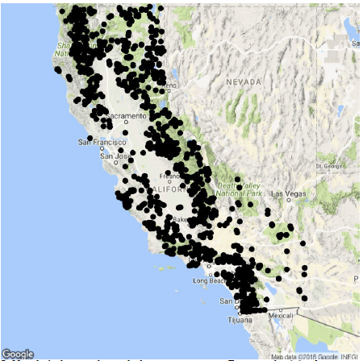
Exercise 2(cont…)
#use geom_point() to display the points. The x and y properties of the aes() function are used to define the geometry
ggmap(myMap) + geom_point(data=df, aes(x = DLONGITUDE, y = DLATITUDE))

Slide 14
Exercise 2(cont…)
2. Now let’s do something a little more interesting. First, use the dplyr function mutate() to group the fires by decade.
1989", ifelse(YEAR_ %in% 1990:1999, "1990-1999", ifelse(YEAR_ %in%2000:2009, "2000-2009", ifelse(YEAR_ %in% 2010:2016, “2010-2016","-99")))))
3. Next, color code the wildfires by DECADE and create a graduated symbol map based on the size of each fire. The colour property defines the column to use for grouping, and the size property define the column to use for the size of each symbol.
ggmap(myMap) + geom_point(data=df, aes(x = DLONGITUDE, y =DLATITUDE, colour= DECADE, size = TOTALACRES))

Slide 15
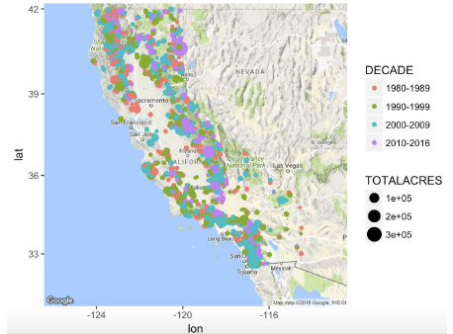
Exercise 2(cont…)

Slide 16
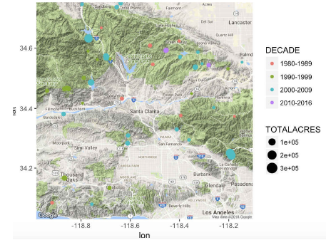
Exercise 2(cont…)
4. Let’s change the map view to focus more on southern California, and in particular the area just north of Los Angeles.
myMap <- get_map(location = "Santa Clarita, California ", zoom = 10)
ggmap(myMap) + geom_point(data=df, aes(x = DLONGITUDE, y =
DLATITUDE, colour= DECADE, size = TOTALACRES))

Slide 17
Exercise 2(cont…)
5. Next, add contour and heat layers.
The geom_density2d() function is used to create the contours while the stat_density2d() function creates the heat map.
You can experiment with the colors using the
scale_fill_gradient(low and high) properties.
Here we’ve set them to green and red respectively, but you may want to change the color scheme.
myMap <- get_map(location = “California”, zoom = 6)

Slide 18
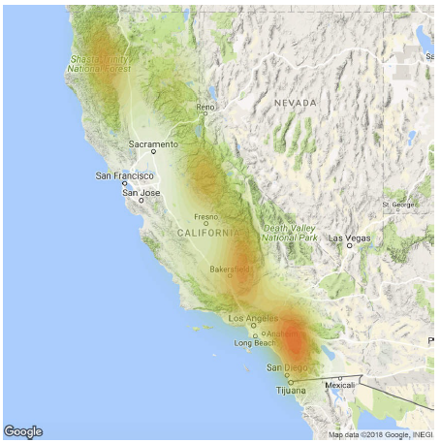
Exercise 2(cont…)
ggmap(myMap, extent = “device”) + geom_density2d(data = df, aes(x =DLONGITUDE, y = DLATITUDE), size = 0.3) + stat_density2d(data = df, aes(x= DLONGITUDE, y = DLATITUDE, fill = ..level.., alpha = ..level..), size =0.01, bins = 16, geom = “polygon”) + scale_fill_ gradient(low = “green”, high =“red”) + scale_alpha(range = c(0, 0.3), guide = FALSE)

Slide 19
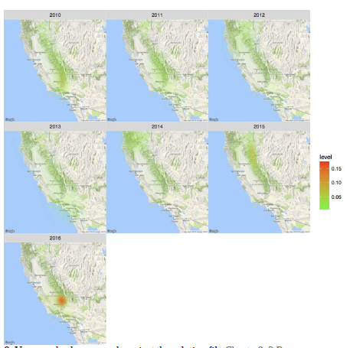
Exercise 2(cont…)

Slide 20
Adding Layers from Shapefiles:
Shapefiles is an older GIS data format, are still commonly used to represent geographic features.
With a little bit of manipulation, you can get plot data from shapefiles onto ggmap.
Exercise 3:
Install an additional package called rgdal. Use the Packages pane to
find and install rgdal or enter the code you see below.
install.packages("rgdal")
2. Load the rgdal package through the Packages pane or enter the
code you see below.
library(rgdal)

Slide 21
Exercise 3 (cont…)
3. Use the readOGR() function from rgdal to load the
S_USA.Wilderness data into a variable.
wild = readOGR( '.', 'S_USA.Wilderness')
4. The fortify() function, which is part of ggplot2, converts all the
individual points that define each boundary into a data frame that
can then be used to plot the polygon boundaries.
wild <- fortify(wild)

Slide 22
Exercise 3 (cont…)
5. Use the ggmap - qmap() function (qmap means quick map) to
create the basemap that will be used as the reference for the
wilderness boundaries.
Center the map in Montana.
montana <- qmap("Montana", zoom=6)
6. Before plotting the wilderness boundaries as polygons on the map,
take a look at the data frame that was created by the fortify()
function so you’ll have a better understanding of the structure
created by this function.
View(wild)

Slide 23
Exercise 3 (cont…)
7. Now plot the wilderness boundaries on the basemap. Notice the
use of the group column for grouping the polygons. It does take
some time to plot the boundaries on the map so be patient with
this step.
montana + geom_polygon(aes(x=long,y=lat, group=group, alpha=0.25), data=wild, fill=’white’) + geom_polygon(aes(x=long,y=lat, group=group), data=wild, color=‘balck’, fill=NA)

Slide 24
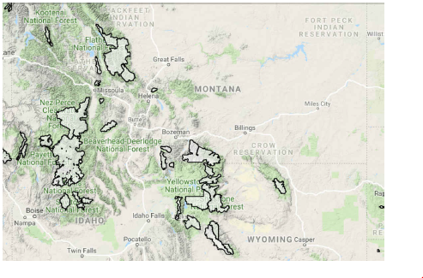
Exercise 3 (cont…)
8. Optional – Use the color, fill, and alpha (used to define transparency) parameters to change the symbology to different colors and styles.

